Slide 1

A PROJECT REPORT
on
“TIMETABLE GENERATOR”
Submitted by
Mr. YASH NIKHIL DEBNATH
SEAT NO : 2221033
in partial fulfillment for the award of the degree
of
BACHELOR OF SCIENCE
In
COMPUTER SCIENCE
under the guidance of
Mrs. SWETHA IYER
Department of Computer Science
VIDYAVARDHINI’S
A. V. COLLEGE OF ARTS, K. M. COLLEGE OF COMMERCE,
E. S. A. COLLEGE OF SCIENCE, VASAI (WEST), PALGHAR-401208,
MAHARASHTRA
(SEM-VI) (2023-2024)
1

Slide 2
ACKNOWLEDGMENT
I would like to acknowledge my sincere thanks towards our project guide
Head of Computer Science Department
Mrs. Srimathi Narayanan
For their valuable guidance and suggestions and providing me an opportunity to do the project work in the college lab and
Which made me complete the project successfully.
I am also thankful to
Mrs. Swetha Iyer
For providing such nice guidance in form of comments and corrections. I am thankful to and fortunate enough to get constant encouragement,
support and guidance from all teaching staff of Computer Science which helped us in successfully completing our project work. Also, I would like to extend our sincere esteems to all staffs in laboratory for their timely support.
- YASH NIKHIL DEBNATH
T.Y.BSC (Computer Science)
2

Slide 3
DECLARATION
I YASH NIKHIL DEBNATH hereby declare that the project entitled “TIMETABLE GENERATOR” submitted in the partial fulfillment for the award of Bachelor of Science in Computer Science during the academic year 2023 – 2024 is my original work and the project has not formed the basis for the award of any degree, associate ship, fellowship or any other similar titles.
Signature of the Student:
Place:
Date:
3

Slide 4
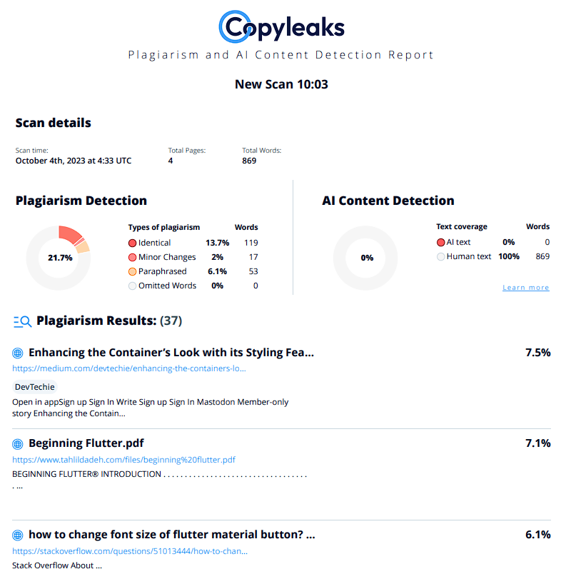
PLAGARISM REPORT
4

Slide 5
Gantt Chart
5

Slide 6
INDEX PAGE
Sr. No | Contents | Page No. | SIGN
1. | Introduction (Synopsis) | 7
2. | Limitation of Current System | 8
3. | Advantage of Proposed System | 8
4. | Feasibility Study Technical Feasibility Economical Feasibility Organizational Feasibility Cultural Feasibility | 9-10
5. | Requirement Specification (Software and Hardware Req.) | 11
6. | System Design Details Event Table Entity Relationship Diagram Class Diagram Use Case Diagram Activity Diagram Sequence Diagram Component Diagram Deployment Diagram Database Table | 12-23
7. | System Implementation (CODE) | 24-33
8. | Result (Screenshot) | 34-42
9. | Future Scope and Conclusion | 43
10. | Reference | 43

Slide 7
INTRODUCTION
TITLE OF PROJECT :- Timetable Generator
OBJECTIVE OF PROJECT:- The aim of creating a timetable generator is to provide college organization with a convenient tool for organizing their schedules effectively. This tool aims to streamline the process of scheduling by automating the allocation of time slots for various activities, classes, or appointments. The primary goal is to optimize time management, minimize conflicts, and enhance productivity for individuals, students, or professionals.
LANGUAGE AND SOFTWARE TOOLS USED:- LANGUAGE:- PHP, HTML, CSS, Javascript, MYSQL SOFTWARE: Xampp ,VSCode
SCOPE OF THE PROJECT:- The project aims to develop a timetable generation system for colleges, addressing the challenge of scheduling faculty members across various courses and subjects. With limited faculty resources, the system aims to optimize scheduling to prevent overlaps and efficiently meet subject demands. A genetic algorithm approach will be used for this purpose. The system will utilize a timetable object, comprising Classroom objects, each with its timetable and a fitness score based on clashes between different class schedules. Each Classroom object will consist of week objects, further divided into Days, and Days will include Timeslots. Timeslots will contain information about subjects, student groups, and assigned faculty. Additionally, the system will employ a composite design pattern to facilitate scalability and flexibility. This design allows for easy addition or removal of constraints. Clash detection between timetable objects will be performed in each constraint class, with the score incremented if a clash is detected. Moreover, it will emphasize extensibility, allowing for future enhancements and modifications to accommodate evolving organizational needs. Key features include:
Utilization of Genetic Algorithm
Timetable Object Structure
Composite Design Pattern Implementation
Clash Resolution Algorithms
Optimization Techniques
Extensible Design Architecture

Slide 8
LIMITATIONS
Maintenance and Updates: Regular maintenance and updates are necessary for PHP-based solutions to keep pace with evolving college schedules, preferences, and regulations. Lack of proper version control and documentation can make maintenance challenging.
Optimization: PHP may not deliver the performance needed for efficient optimization algorithms required to generate optimal timetables, especially with large datasets and complex constraints.
Performance: PHP's performance may not match that of other programming languages or dedicated timetable generation software, particularly when dealing with intricate scheduling algorithms and large datasets.
ADVANTAGES
Eliminate Paper-based Processes: Transition from traditional paper-based timetabling to digital solutions, reducing reliance on physical documents and streamlining administrative workflows.
Intuitive & User-friendly: Design an interface that is easy to navigate and understand, ensuring users can interact with the timetable generator without extensive training or technical knowledge.
Automatic Timetable Scheduling: Implement algorithms to automate the scheduling process, minimizing manual intervention and ensuring efficient allocation of resources.
Time-saving: Automate timetable creation to save time and effort, particularly beneficial for large institutions with complex scheduling requirements.
Scalability: Ensure the timetable generator can adapt to the needs of institutions of varying sizes, accommodating growth without compromising performance or functionality.
Accessibility: Offer web-based access to timetables, allowing users to view schedules from any location with an internet connection, promoting transparency and ease of access.
.

Slide 9
FEASIBILITY STUDY
A Feasibility study is an important step in the project planning process, as it helps determine whether the proposed project is practical, viable, and achievable. It assesses the potential risks, costs, benefits, and resources required for the successful completion of the project. In simplest terms, the two criteria to judge feasibility are cost required and value to be attained.
A. Technical Feasibility:
Assess the technical feasibility of implementing the timetable generator, including the availability of required technology and software development resources.
Evaluate the compatibility of the proposed system with existing college infrastructure and systems.
Determine the feasibility of integrating the genetic algorithm and composite design pattern into the system architecture.
Identify potential technical challenges and risks associated with implementation and maintenance.
B. Economical Feasibility: -
Conduct a cost-benefit analysis to determine the financial feasibility of developing and deploying the timetable generator.
Estimate the initial development costs, including software development, hardware infrastructure, and licensing fees.
Evaluate the potential savings or revenue generation opportunities resulting from improved scheduling efficiency and resource utilization.
Consider the long-term operational and maintenance costs, including software updates, technical support, and staff training.

Slide 10
C. Organizational Feasibility:
Assess the organizational feasibility of implementing the timetable generator within the college structure.
Evaluate the support and commitment of key stakeholders, including college administrators, faculty members, and students.
Identify potential organizational barriers or resistance to change and develop strategies to address them.
Determine the feasibility of aligning the timetable generator with college policies, procedures, and academic requirements.
D. Cultural Feasibility:
Evaluate the cultural feasibility of introducing the timetable generator within the college community.
Assess the readiness of faculty members and staff to adopt new technology and embrace changes to scheduling practices.
Consider the impact of cultural factors such as organizational hierarchy, communication norms, and resistance to technology adoption.
Identify cultural barriers that may affect the acceptance and effectiveness of the timetable generator and develop strategies to mitigate them.

Slide 11
REQUIREMENT SPECIFICATION
Hardware Requirements:
Processor : Intel Core i3
Hard Disk : 60GB
RAM : 4GB
Monitor: LCD Colour
Mouse: Optical
Software Requirements:
Operating System: Windows 10,11
Language : PHP ,HTML ,CSS ,Javascript
Frontend: HTML ,CSS ,Javascript
Backend: PHP
Database :MYSQL
Software: Xampp ,VSCode

Slide 12
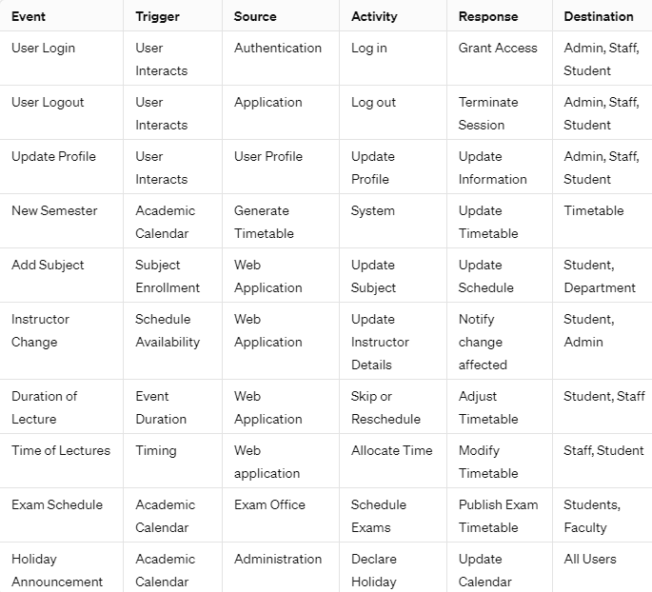
EVENT TABLE

Slide 13
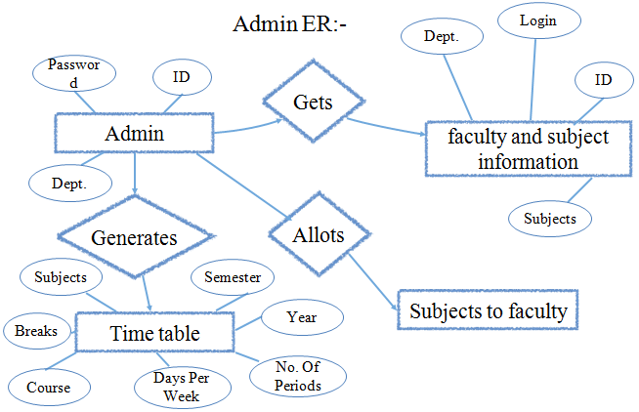
E-R DIAGRAM

Slide 14
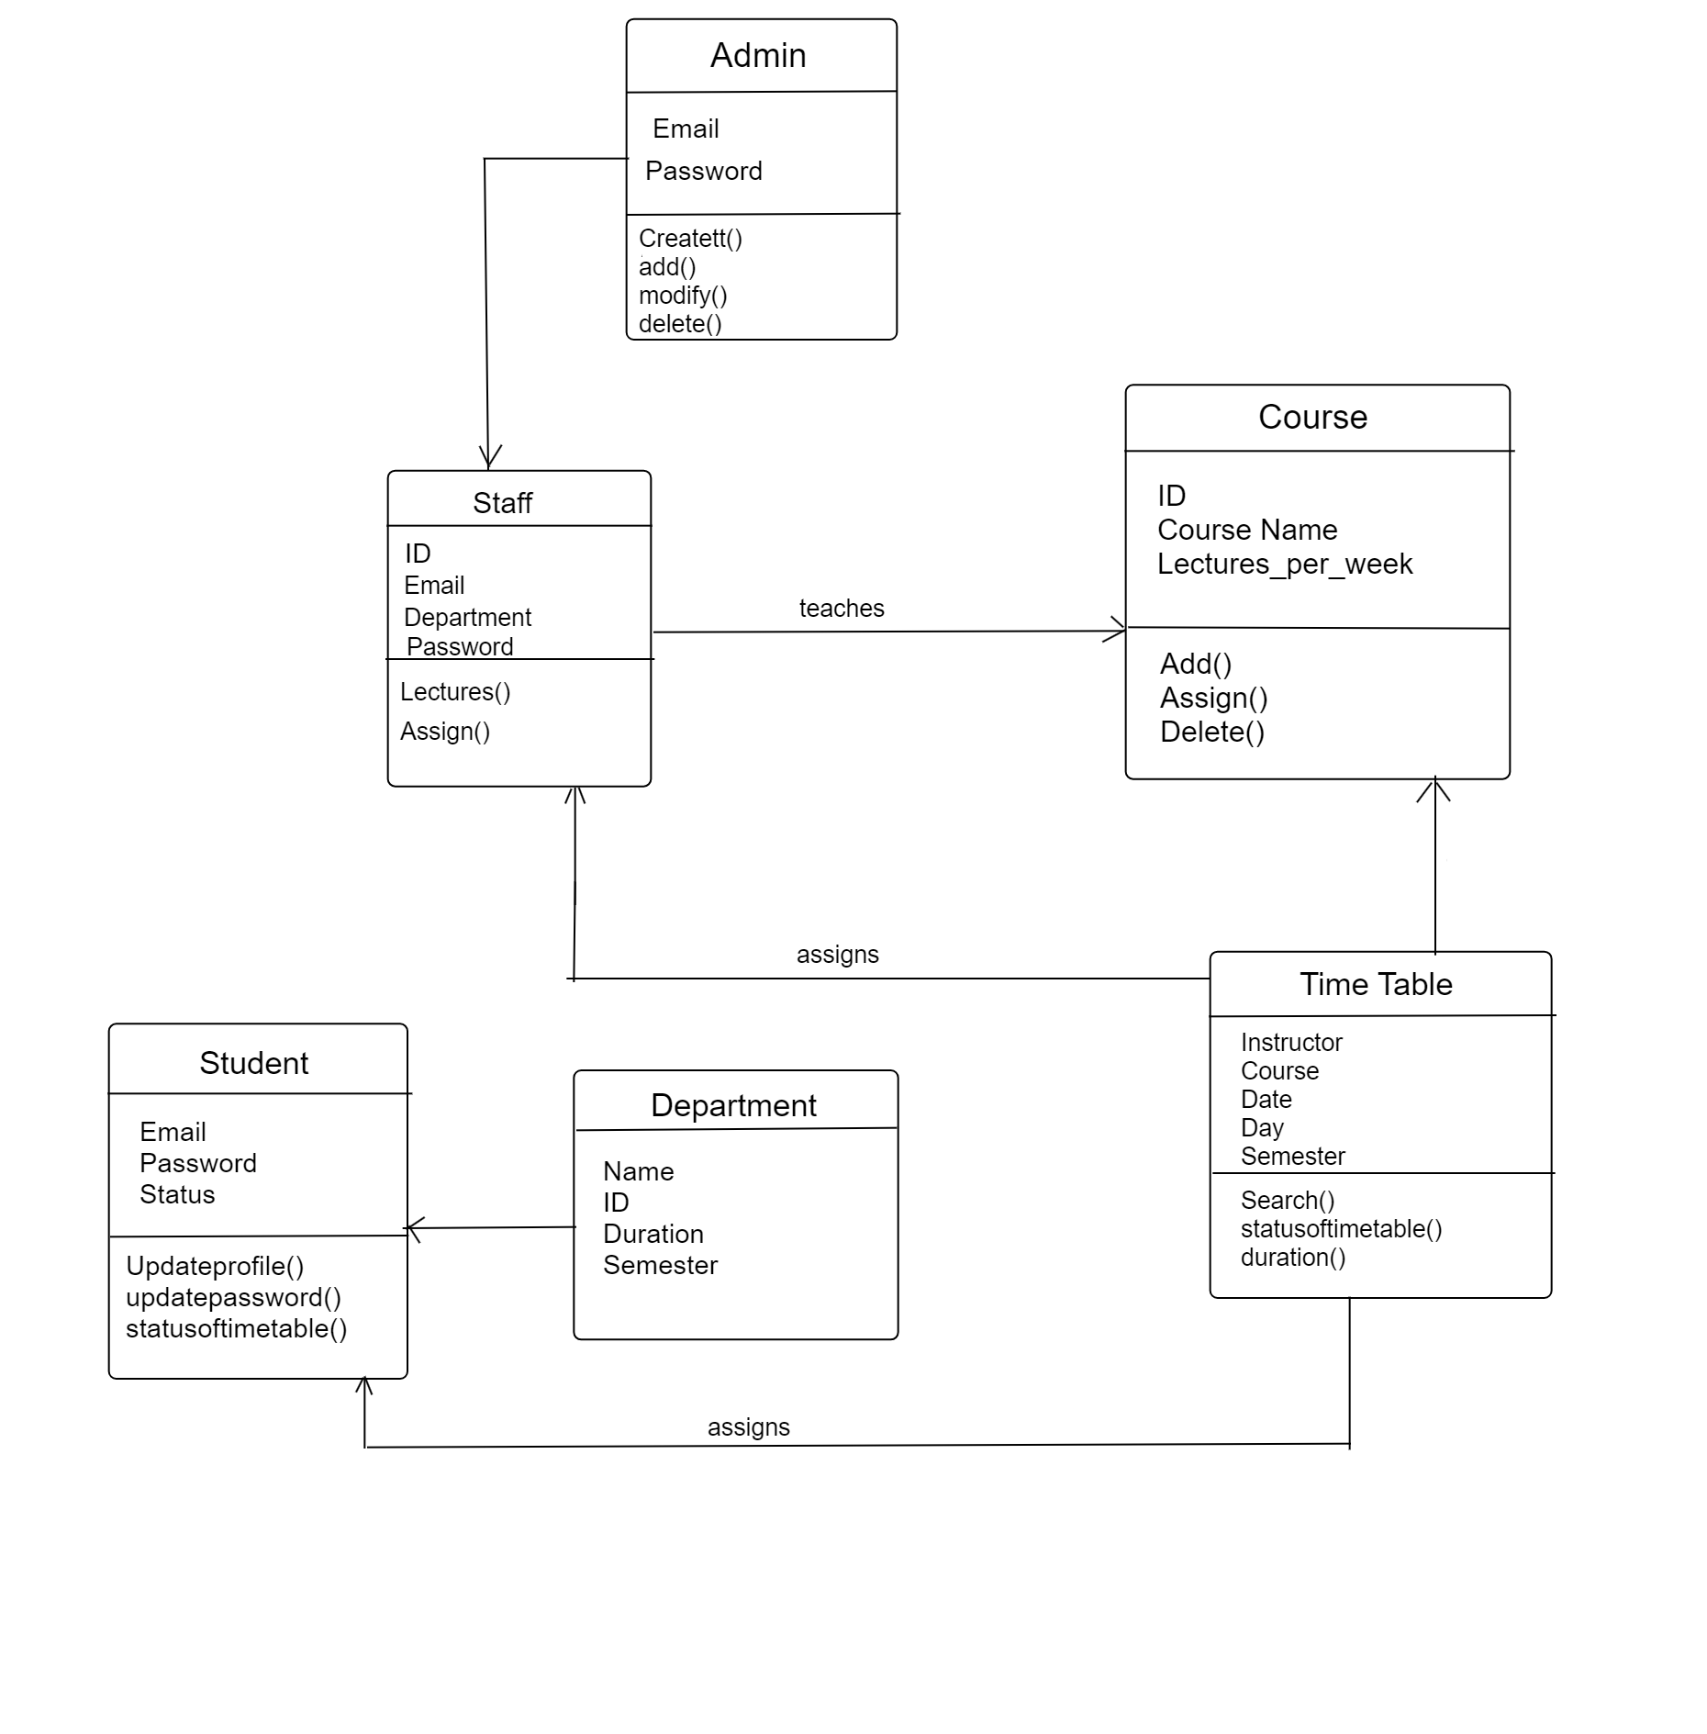
CLASS DIAGRAM

Slide 15
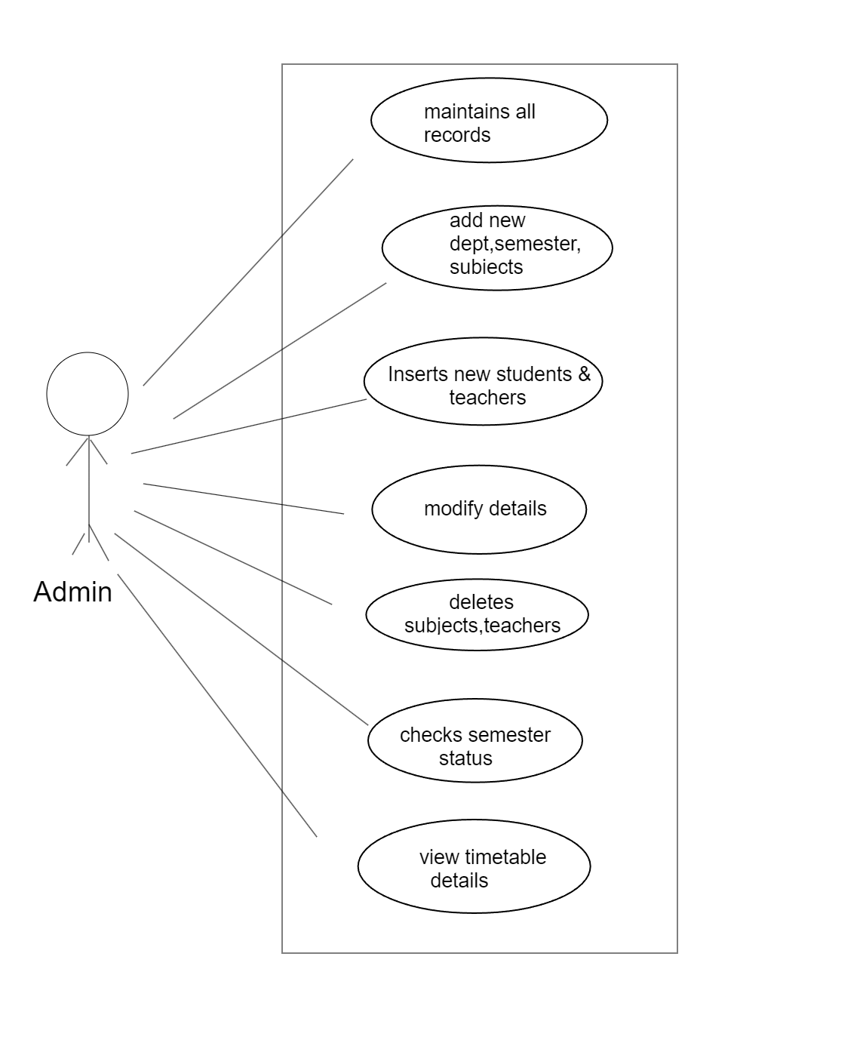
USE CASE DIAGRAM

Slide 16
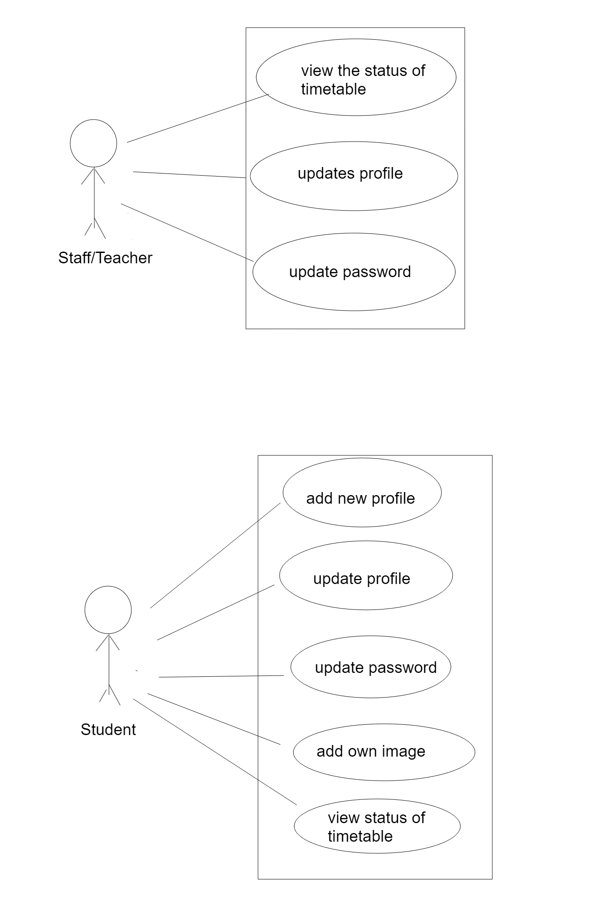
USE CASE DIAGRAM

Slide 17
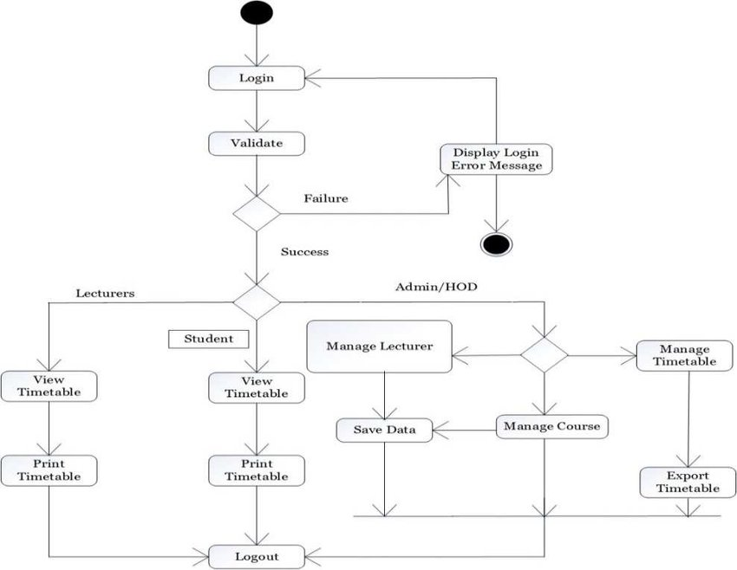
ACTIVITY DIAGRAM

Slide 18
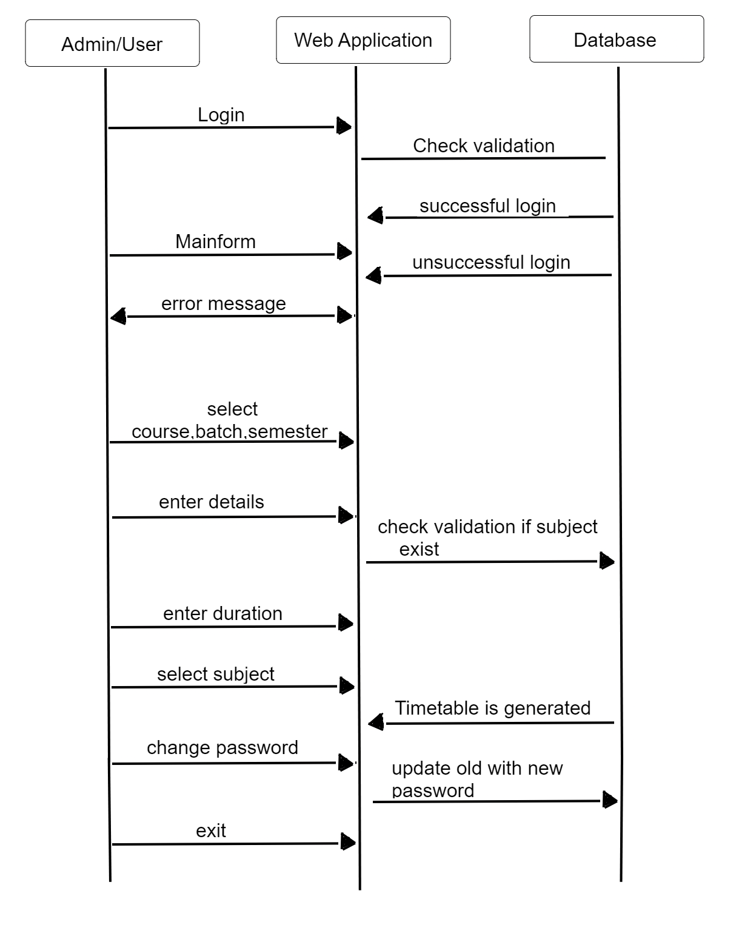
SEQUENCE DIAGRAM

Slide 19
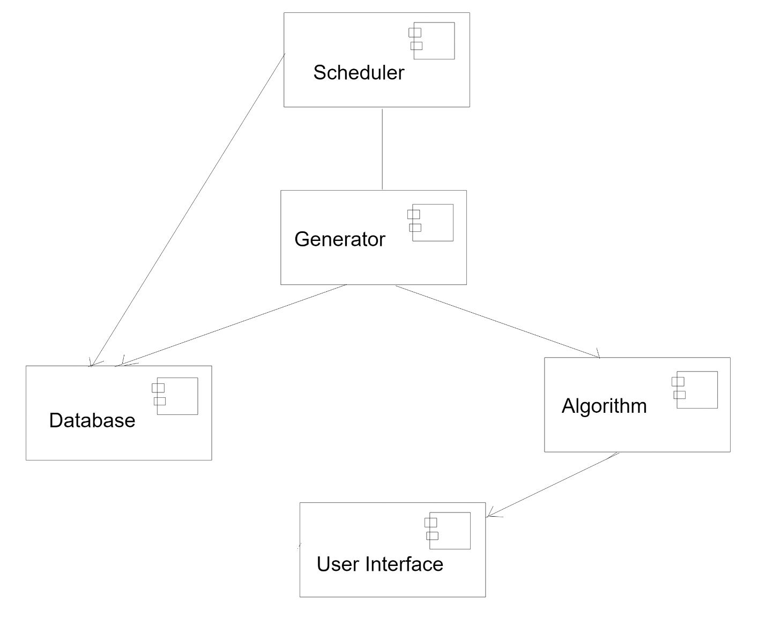
COMPONENT DIAGRAM

Slide 20
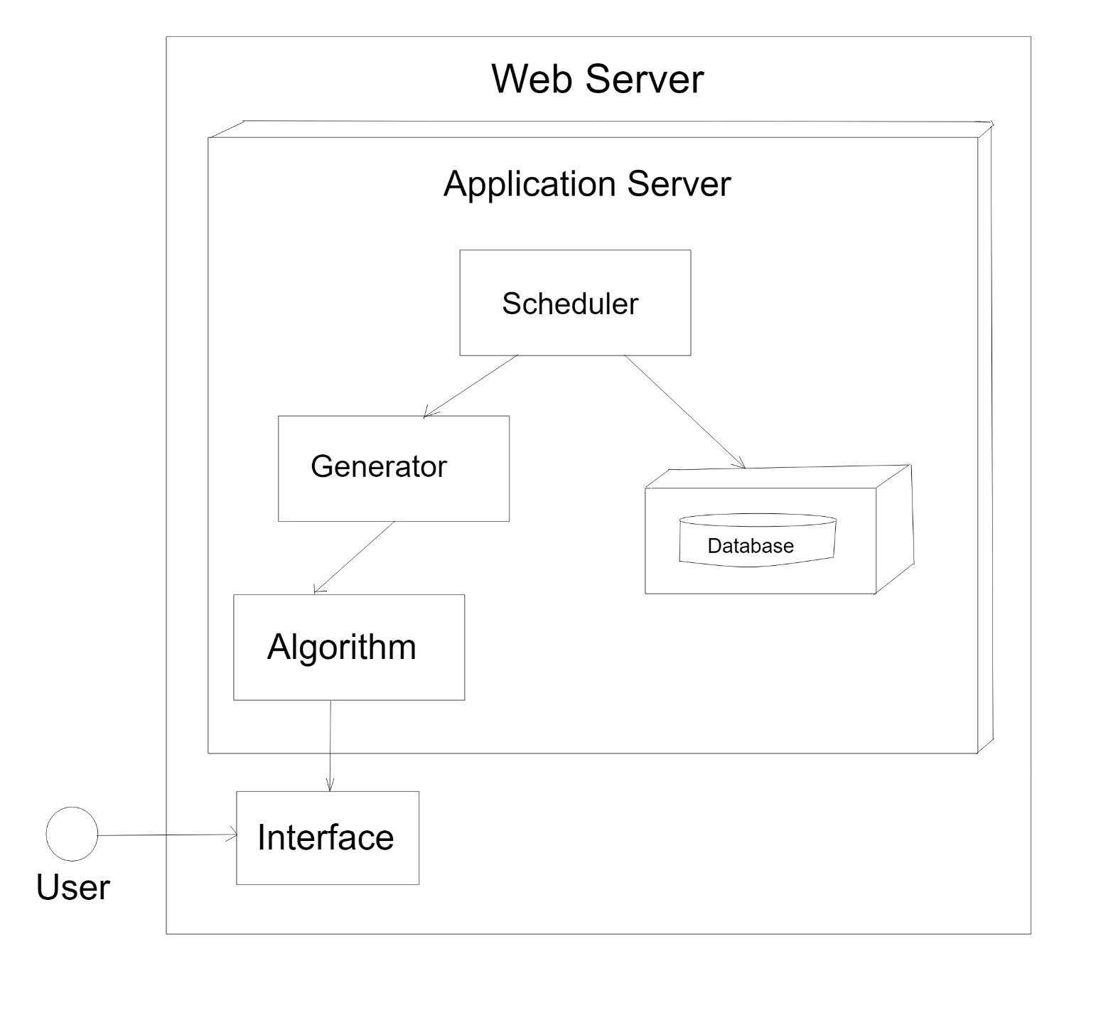
DEPLOYMENT DIAGRAM

Slide 21
DATABASE TABLE
1.Admin
Field_Name | Data_Type | Constraint
User_id | Int | Primary key/Unique
User_name | Varchar | -
Password | Varchar | -
eid | varchar | -
2.Contactus
Field_Name | Data_Type | Constraint
Id | int | Primary key
Name | varchar | -
email | Varchar | -
subject | Varchar | -
message | varchar | -
3.Department
Field_Name | Data_Type | Constraint
Department_id | Int | Primary key
Department_name | Varchar | -

Slide 22
4.Semester
Field_Name | Data_Type | Constraint
Sem_id | int | Primary key
Semester_name | varchar | -
Department_id | Varchar | -
5.Subject
Field_Name | Data_Type | Constraint
subject_id | Int | Primary key/Unique
subject_name | Varchar | -
Sem_id | Varchar | -
Department_id | varchar | -
6.TimeTable
Field_Name | Data_Type | Constraint
Timeschedule_id | Int | Primary key
Department_name | Varchar | -
Semester_name | Varchar | -
Subject_name | Varchar
time | Varchar
date | Varchar | -
Teacher_id | int | -

Slide 23
Student
Field_Name | Data_Type
Id | Int
Name | Varchar
Eid | Varchar
Password | Varchar
Mob | Bigint
Address | Varchar
Dept_id | Int
Sem_id | Int
Dob | Date
Pic | Varchar
Gender | Enum(‘m’,’f’)
Status | Varchar
Date | date
Teacher
Field_Name | Data_Type
Teacher_id | Int
Name | Varchar
Eid | Varchar
Password | Varchar
Mob | Bigint
Address | Varchar
Dept_id | Int
Sem_id | Int
status | varchar
Date | date

Slide 24
IMPLEMENTATION
admindashboard.php
<?php
session_start();
include('../config.php');
if($_SESSION['admin']=="")
{
$que=mysqli_query($con,"select * from admin where user_name='".$_SESSION['admin']."'");
$res=mysqli_fetch_array($que);
$_SESSION=$res;
}
?>
<!DOCTYPE html>
<html lang="en">
<head>
<meta charset="utf-8" />
<meta http-equiv="X-UA-Compatible" content="IE=edge" />
<meta name="viewport" content="width=device-width, initial-scale=1" />
<meta name="description" content="" />
<meta name="author" content="" />
<title>Time table Admin Dashboard</title>
<!-- Bootstrap Core CSS -->
<link href="css/bootstrap.min.css" rel="stylesheet" />
<!-- Custom CSS -->
<link href="css/sb-admin.css" rel="stylesheet" />
<!-- Custom Fonts -->
<link
href="font-awesome/css/font-awesome.min.css"
rel="stylesheet"
type="text/css"
/>
<style>
/* @import url('https://fonts.googleapis.com/css2?family=Poppins:ital,wght@0,100;0,200;0,300;0,400;0,500;0,600;0,700;0,800;0,900;1,100;1,200;1,300;1,400;1,500;1,600;1,700;1,800;1,900&display=swap'); */
.navbar-ex1-collapse .side-nav a {
color: white !important;
} .side-nav li a {
font-size: 19px;
padding:20px;
}
</style>
</head>
<body>
<div id="wrapper">
<!-- Navigation -->
<nav class="navbar navbar-inverse navbar-fixed-top" role="navigation">
<!-- Brand and toggle get grouped for better mobile display -->
<div class="navbar-header">
<p>

Slide 25
<span style="color: #fff">Hello Admin</span>
</div>
<!-- Top Menu Items -->
<!-- Sidebar Menu Items - These collapse to the responsive navigation menu on small screens -->
<div class="collapse navbar-collapse navbar-ex1-collapse">
<ul class="nav navbar-nav side-nav" style="background-color: black">
<li>
<a href="admindashboard.php?info=course" style="margin-top:40px;"
><i class="fa fa-fw fa-dashboard"></i>Department</a>
</li>
<li>
<a href="admindashboard.php?info=semester"
><i class="fa fa-fw fa-bar-chart-o"></i>Semester</a>
</li>
<li>
<a href="admindashboard.php?info=subject"
><i class="fa fa-fw fa-table"></i>Subject</a>
</li>
<li>
<a href="admindashboard.php?info=student"
><i class="fa fa-fw fa-edit"></i>Student</a>
</li>
<li>
<a href="admindashboard.php?info=teacher"
><i class="fa fa-fw fa-desktop"></i>Teacher</a>
</li>
<li>
<a href="admindashboard.php?info=timetable"
><i class="fa fa-fw fa-wrench"></i>Time Table</a>
</li>
<br>
<li>
<<a href="logout.php"><font color="#FFFFFF">Logout</font></a>
</li>
</ul>
</div>
<!-- /.navbar-collapse -->
</nav><div id="page-wrapper">
<div class="container-fluid">
<!-- Page Heading -->
<div class="row">
<div<div
style="background-color: white;">
@$info=$_REQUEST['info'];
if($info!="")
{
if($info=="course")
{
include('course.php');
}
elseif($info=="semester")
{
include('semester.php');
}
elseif($info=="subject")
{
include('subject.php');
}
elseif($info=="student")
{
include('student.php');
}
?>

Slide 26
elseif($info=="teacher")
{include('teacher.php');}
elseif($info=="timetable")
{include('timetable.php');}
elseif($info=="add_course")
{include('add_course.php');}
elseif($info=="add_subject")
{nclude('add_subject.php');
elseif($info=="add_semester")
{include('add_semester.php');}
elseif($info=="add_teacher")
{include('add_teacher.php');}
elseif($info=="add_student")
{include('add_student.php');}
elseif($info=="add_timetable")
{include('add_timetable.php');}
elseif($info=="updatecourse")
{include('updatecourse.php');}
elseif($info=="updatesemester")
{include('updatesemester.php');}
elseif($info=="updatesubject")
{include('updatesubject.php');}
elseif($info=="updatestudent")
{include('updatestudent.php');}
elseif($info=="updateteacher")
{include('updateteacher.php');}
elseif($info=="updatetimetable")
{include('update_timetable.php');}
}
else
{
?>
<font
color="#FF3333"
size="+3"
style="margin-left: 435px"
>Admin Panel</font
><br />
<img
src="img/admin.jpg"
class="img-responsive"
alt="Cinque Terre"
width="500"
height="500"
style=" margin-left: 260px"
/>
<?php
}?>
</div></div>
</div></div>
</div>
<!-- jQuery -->
<script src="js/jquery.js"></script>
<!-- Bootstrap Core JavaScript -->
<script src="js/bootstrap.min.js"></script>
</body>
</html>

Slide 27
timeschedule.php
<?php
echo "<table border='2px' class='table' height='500px'>";
echo "<Tr>
<th><font color='black'><h3>Time Schdule Id</h3></font></th>
<th><font color='black'><h3>Department</h3></font></th>
<th><font color='black'><h3>Subject Name</h3></font></th>
<th><font color='black'><h3>Semester Name</h3></font></th>
<th><font color='black'><h3>Teacher Name</h3></font></th>
<th><font color='black'><h3>Time</h3></font></th>
<th><font color='black'><h3>Date</h3></font></th>
</tr>";
$que=mysqli_query($con,"select * from timeschedule where teacher_id='".$_SESSION['teacher_id']."'");
while($res=mysqli_fetch_array($que))
{
echo "<tr>";
echo "<td style='color:black'>".$res['timeschedule_id']."</td>" ;
//display department name
$que2=mysqli_query($con,"select * from department where department_id='".$res['department_name']."'");
$res2=mysqli_fetch_array($que2);
echo "<td style='color:black'>".$res2['department_name']."</td>" ;
//display subject name
$que3=mysqli_query($con,"select * from subject where subject_id='".$res['subject_name']."'");
$res3=mysqli_fetch_array($que3);
echo "<td style='color:black'>".$res3['subject_name']."</td>" ;
//display semester name
$que4=mysqli_query($con,"select * from semester where sem_id='".$res['semester_name']."'");
$res4=mysqli_fetch_array($que4);
echo "<td style='color:black'>".$res4['semester_name']."</td>" ;
//display teacher name
$que5=mysqli_query($con,"select * from teacher where teacher_id='".$res['teacher_id']."'");
$res5=mysqli_fetch_array($que5);
echo "<td style='color:black'>".$res5['name']."</td>" ;
echo "<td style='color:black'>".$res['time']."</td>" ;
echo "<td style='color:black'>".$res['date']."</td>" ;
?>
<?php
echo "</tr>";
}
echo "</table>";
?>

Slide 28
updateprofile.php
<?php
include('../config.php');
$q=mysqli_query($con,"select * from student where stu_id='".$_SESSION['stu_id']."'");
$res=mysqli_fetch_assoc($q);
$opass=$res['password'];
extract($_POST);
if(isset($update))
{
if($np=="" || $op=="" || $cp=="")
{
$err="<font color='red'>fill all the fields first</font>";
}
else
{
if($op==$opass)
{
if($np==$cp)
{
mysqli_query($con,"UPDATE student SET password='$np' where stu_id='".$_SESSION['stu_id']."'");
$err="<font color='blue'>Password Updated</font>";}
else{
$err="<font color='red'>New password not equal to confirm password</font>";}}
else{
$err="<font color='red'>Old Pass not matched</font>";}}}
?>
<div class="row" style="height:700px">
<div class="col-md-5">
<h2><font color="#FFFFFF">Update Password</font></h2>
<form method="POST" enctype="multipart/form-data">
<table border="0" cellspacing="5" cellpadding="5" class="table">
<tr>
<th><h3><?php echo $err; ?></h3></th>
</tr>
<tr>
<th width="237" scope="row"><font color="#FFFFFF" size="+2">Old Password</font> </th>
<td width="213"><input type="text" name="op" class="form-control" value="<?php echo $res['password'];?>"/></td>
</tr>
<tr>
<th width="237" scope="row"><font color="#FFFFFF" size="+2">New Password </font></th>
<td width="213"><input type="password" name="np" class="form-control" value="<?php echo $np; ?>"/></td>
</tr>
<tr>
<th width="237" scope="row"><font color="#FFFFFF" size="+2">Confirm Password</font> </th>
<td width="213"><input type="password" name="cp" class="form-control" value="<?php echo $cp; ?>"/></td>
</tr>
<tr>
<th colspan="2" scope="row" align="center">
<input type="submit" value="Update Records" class="btn btn-default" name="update"/>
</th>
</tr>
</table>
</form>
</div>
</div>

Slide 29
config.php
<?php
error_reporting(1);
$con=mysqli_connect("localhost","root","","timetable") or die(mysql_error);
?>
logout.php
<?php
session_start();
unset($_SESSION['admin']);
header('location:index.php');
?>
course_ajax.php
<strong><option value="" selected="selected" disabled="disabled">Select Semester</option>
<?php
include('../config.php');
$q=mysqli_query($con,"select * from department where department_id='".$_GET['id']."'");
while($res=mysqli_fetch_assoc($q))
{
echo "<option value='".$res['department_id']."'>".$res['department_name']."</option>";}
?>
delete_timetable.php
<?php
include('../config.php');
$tid=$_REQUEST['timeschedule_id'];
if(isset($_REQUEST['timeschedule_id']))
{
mysqli_query($con,"delete from timeschedule where timeschedule_id='$tid'");
header('location:admindashboard.php?info=timetable');
}
?>
Update_student_ajax.php
<option value="" selected="selected" disabled="disabled">Select Subject</option>
<?php
include('../config.php');
$q=mysqli_query($con,"select * from semester where department_id='".$_GET['id']."'");
while($res=mysqli_fetch_assoc($q))
{
echo "<option value='".$res['sem_id']."'>".$res['semester_name']."</option>";
}
?>

Slide 30
timetable.php
<script>
function deleteData(id){
if(confirm("You want to delete?")
){
window.location.href="delete_timetable.php?timeschedule_id="+id;}
}
</script>
<h1 style='padding-bottom:10px;color:rgb(31 41 55 / var(--tw-text-opacity));'>Time Table</h1>
<?php
include('../config.php');
echo "<table border='2px' class='table'>";
echo "<tr class='danger'><th colspan='9'><a href='admindashboard.php?info=add_timetable'>Add New</a></th></tr>";
echo "<tr>
<th>Time Schedule Id</th><th>Department</th><th>Subject Name</th><th>Semester Name</th><th>Teacher Name</th><th>Time</th><th>Date</th><th>Update</th><th>Delete</th></tr>";
$que=mysqli_query($con, "SELECT * FROM timeschedule");
while($res=mysqli_fetch_array($que)){
echo "<tr>";
echo "<td>".$res['timeschedule_id']."</td>";
// Display department name
$que2=mysqli_query($con, "SELECT * FROM department WHERE department_id='".$res['department_name']."'");
$res2=mysqli_fetch_array($que2);
echo "<td>".$res2['department_name']."</td>";
// Display subject name
$que3=mysqli_query($con, "SELECT * FROM subject WHERE subject_id='".$res['subject_name']."'");
$res3=mysqli_fetch_array($que3);
echo "<td>".$res3['subject_name']."</td>";
// Display semester name
$que4=mysqli_query($con, "SELECT * FROM semester WHERE sem_id='".$res['semester_name']."'");
$res4=mysqli_fetch_array($que4);
echo "<td>".$res4['semester_name']."</td>";
// Display teacher name
$que5=mysqli_query($con, "SELECT * FROM teacher WHERE teacher_id='".$res['teacher_id']."'");
$res5=mysqli_fetch_array($que5);
echo "<td>".$res5['name']."</td>";
echo "<td>".$res['time']."</td>";
echo "<td>".$res['date']."</td>";
echo "<td><a href='admindashboard.php?info=updatetimetable&timeschedule_id=".$res['timeschedule_id']."'>Update</a></td>";
echo "<td><a href='javascript:deleteData(\"".$res['timeschedule_id']."\")'>Delete</a></td>";
echo "</tr>";
}
echo "</table>";
?>

Slide 31
carousal.html
<!DOCTYPE html>
<html lang="en">
<head>
<title>Bootstrap Example</title>
<meta charset="utf-8">
<meta name="viewport" content="width=device-width, initial-scale=1">
<link rel="stylesheet" href="css/bootstrap.css">
<script src="js/jquery-2.1.3.min.js"></script>
<script src="js/bootstrap.min.js"></script>
<style>
.carousel-inner > .item > img,
.carousel-inner > .item > a > img {
margin: auto;
}
</style>
</head>
<body>
<div class="container">
<div class="row well">
<div class="col-lg-12"><img src="carousal/image/food-beverage-header-3016-800x200.jpg" /></div>
</div><br/>
<div class="row " style="background-color:#009966">
<nav class="navbar navbar-inverse">
<div class="container-fluid">
<ul class="nav navbar-nav">
<li class="active"><a href="#">Home</a></li>
<li><a href="#">About</a></li>
<li class="dropdown">
<a class="dropdown-toggle" data-toggle="dropdown" href="#">Course<span class="caret"></span></a>
<ul class="dropdown-menu">
<li><a href="#">MCA</a></li>
<li><a href="#">MBA</a></li>
<li><a href="#">B.Tech</a></li></ul></li>
<li><a href="#">Gallary</a></li>
<li><a href="#">Contact</a></li>
<li><a href="Registration Form.html">Registration</a></li> </ul>
<ul class="nav navbar-nav navbar-right">
<li><a href="#"><span class="glyphicon glyphicon-user"></span> Sign Up</a></li>
<li><a href="#"><span class="glyphicon glyphicon-log-in"></span> Login</a></li>
</ul></div></nav></div>
<div class="container">
<br>
<div id="myCarousel" class="carousel slide" data-ride="carousel">
<!-- Indicators -->
<ol class="carousel-indicators">
<li data-target="#myCarousel" data-slide-to="0" class="active"></li>
<li data-target="#myCarousel" data-slide-to="1"></li>
<li data-target="#myCarousel" data-slide-to="2"></li>
</ol>
<!-- Wrapper for slides -->
<div class="carousel-inner" role="listbox">
<div class="item active">
<img src="image/red-lonely-chair-website-header-design.jpg" alt="Chania" style="width:1400px;" height="400px;" />
</div>
<div class="item">
<img src="image/purple-lonely-chair-website-header-design.jpg" alt="Chania" style="width:1400px;" height="400px;"/>
</div>

Slide 32
<div class="item">
<img src="image/red-lonely-chair-website-header-design.jpg" alt="Chania" style="width:1400px;"height="400px;"/>
</div>
</div>
<!-- Left and right controls -->
<a class="left carousel-control" href="#myCarousel" role="button" data-slide="prev">
<span class="glyphicon glyphicon-chevron-left" aria-hidden="true"></span>
<span class="sr-only">Previous</span>
</a>
<a class="right carousel-control" href="#myCarousel" role="button" data-slide="next">
<span class="" aria-hidden="true"></span>
<span class="sr-only">Next</span>
</a></div></div>
<div class="container">
<h2>Modal Example</h2>
<!-- Trigger the modal with a button -->
<button type="button" class="btn btn-info btn-lg" data-toggle="modal" data-target="#myModal">Open Modal</button>
<!-- Modal -->
<div class="modal fade" id="myModal" role="dialog">
<div class="modal-dialog">
<!-- Modal content-->
<div class="modal-content">
<div class="modal-header">
<button type="button" class="close" data-dismiss="modal">&times;</button>
<h4 class="modal-title">Modal Header</h4>
</div>
<div class="modal-body">
<div class="container-fluid">
<div class="row">
<div class="col-lg-6 col-md-offset-3">
<form action="css/index.html" method="post">
<div class="panel panel-success">
<div class="panel-heading">
<div class="panel-title">Registration Form</div>
<div class="panel-body">
<div class="form-group">
<label>Name</label>
<div class="input-group">
<input type="text" class="form-control" placeholder="type your name" required/>
<span class="input-group-addon">
<i class="fa fa-user text-primary"></i>
</span></div></div><div class="form-group">
<div class="form-group">
<label>Name</label>
<div class="input-group">
<input type="text" class="form-control" placeholder="type your name" required />
<span class="input-group-addon">
<i class="fa fa-user text-primary">
</i></span> </div></div>
<div class="form-group">
<label>Name</label>
<div class="input-group">
<input type="text" class="form-control" placeholder="type your name" required />
<span class="input-group-addon">
<i class="fa fa-user text-primary">
</i></span> </div></div>
<div class="form-group">
<label>Name</label>
<div class="input-group">

Slide 33
<input type="radio" name="gen" checked>male&nbsp;
<input type="radio" name="gen">Female
</div>
</div>
<div class="panel-footer">
<input type="submit" value="slubmit"></input>
</div>
<div class="modal-footer">
<button type="button" class="btn btn-default" data-dismiss="modal">Close</button>
</div>
</body>
</html>

Slide 34
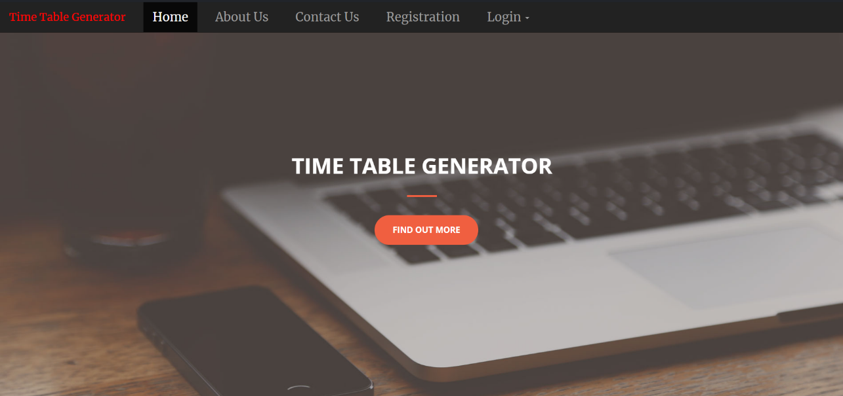
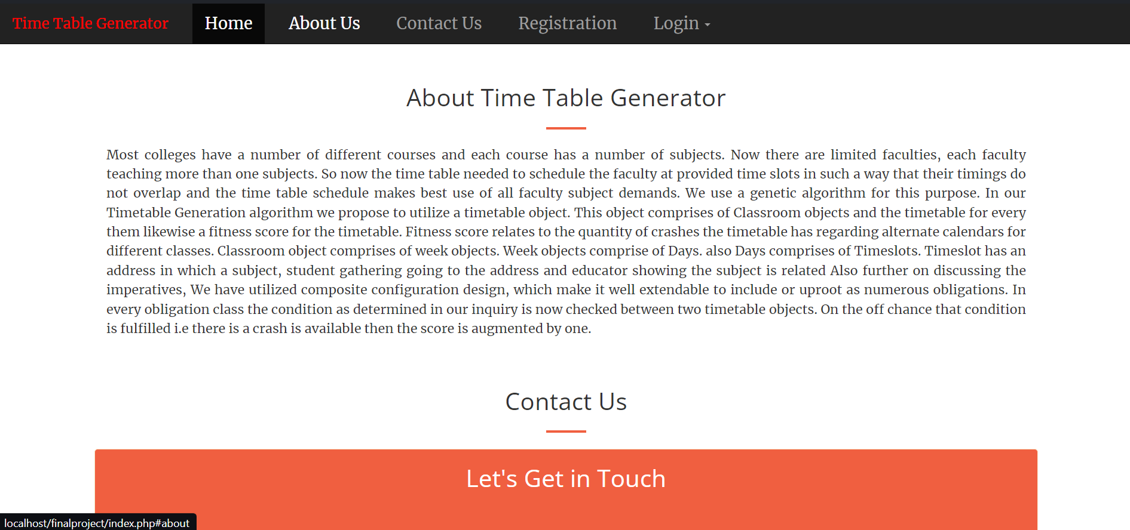
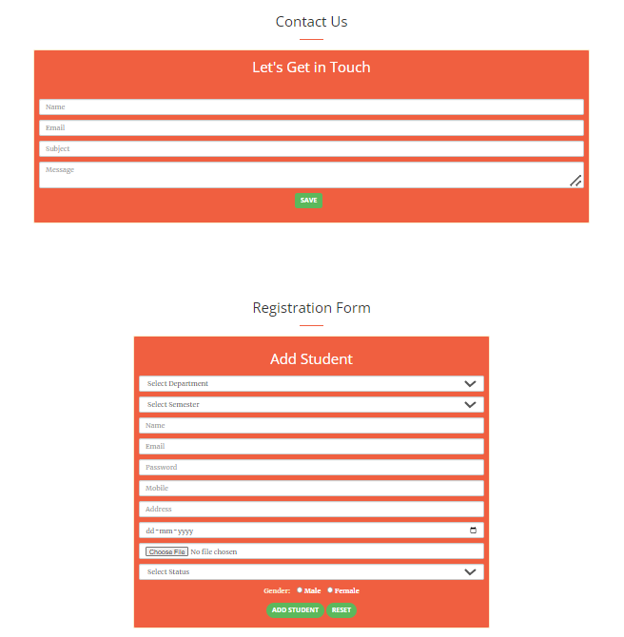
RESULT (SCREENSHOTS)
HomePage

Slide 35

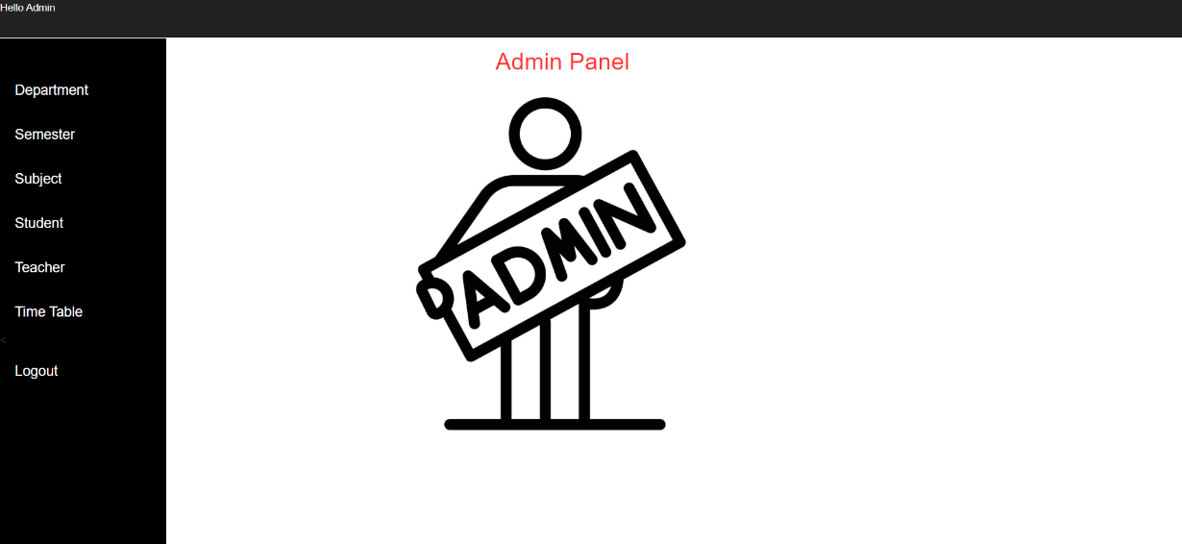
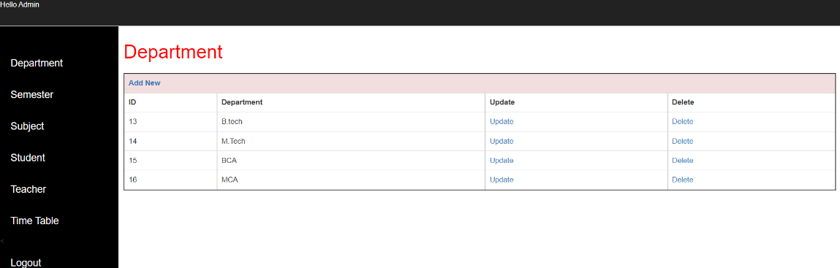
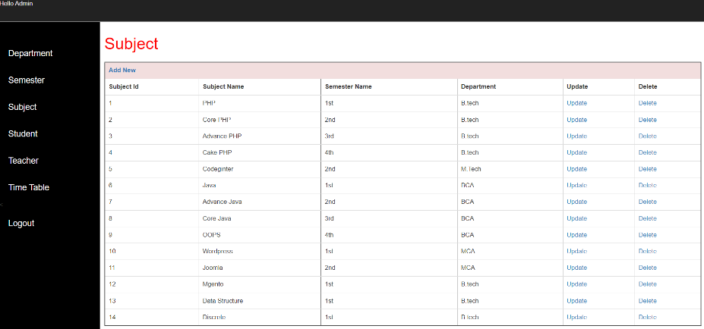
Admin Panel
Admin

Slide 36
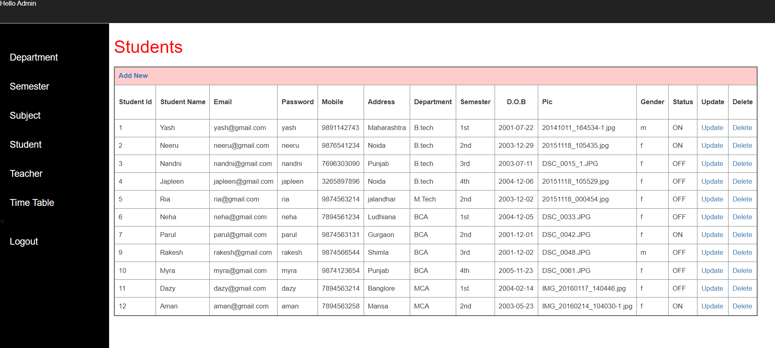
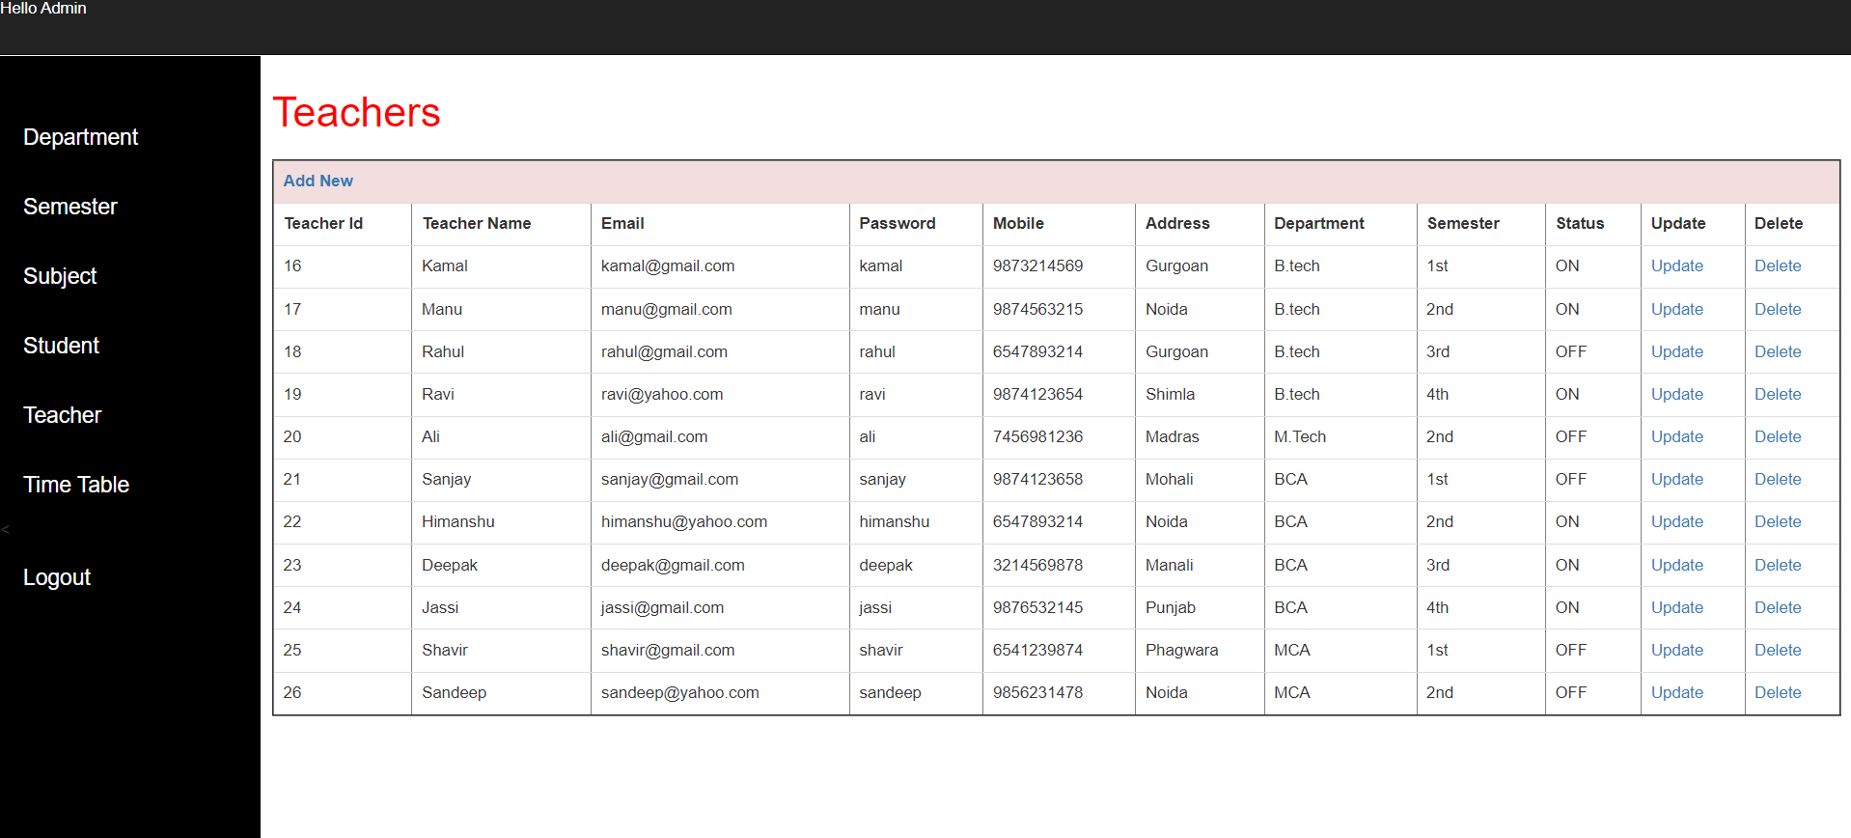
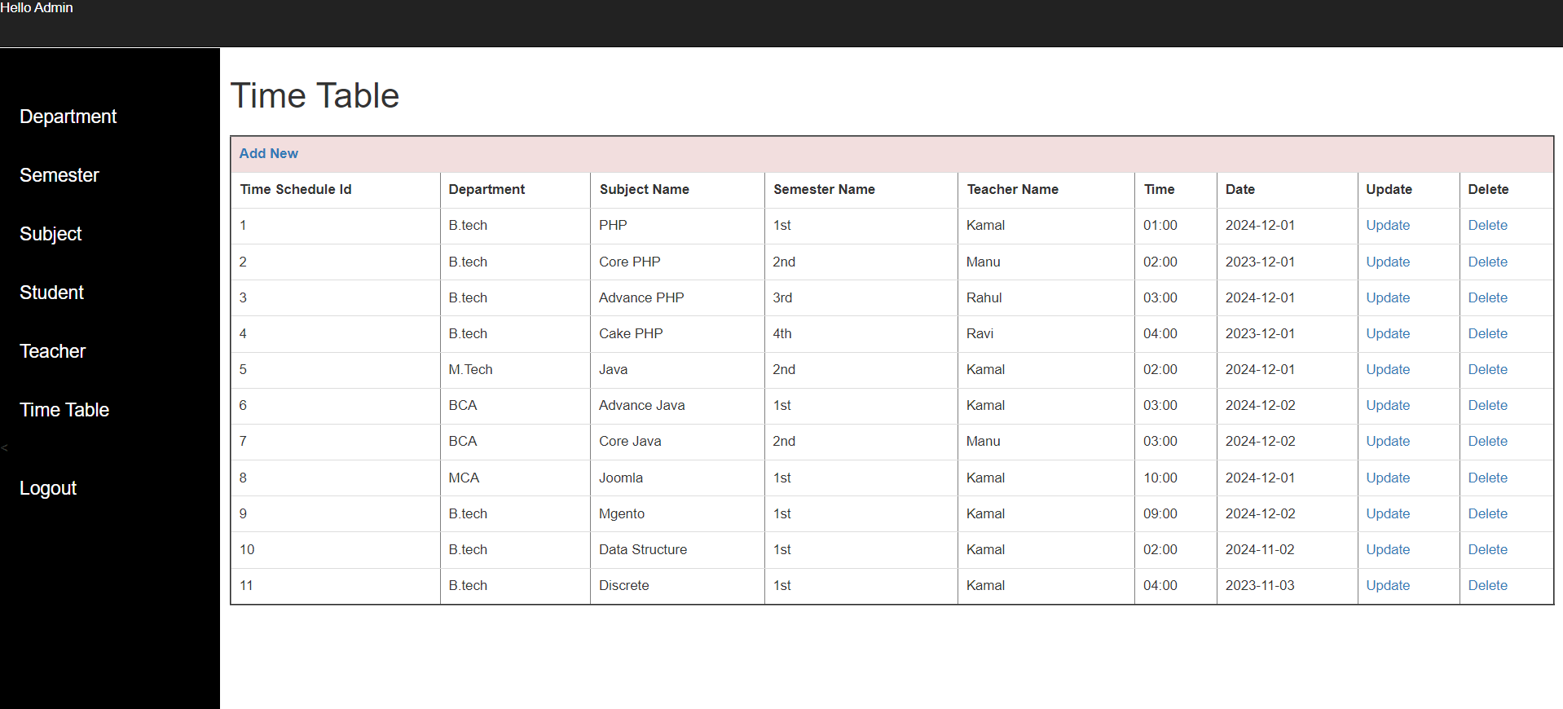

Slide 37
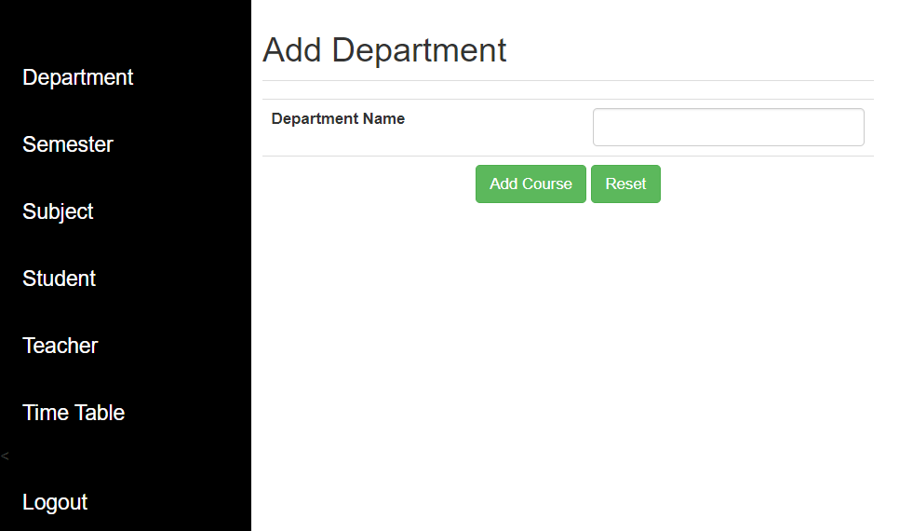
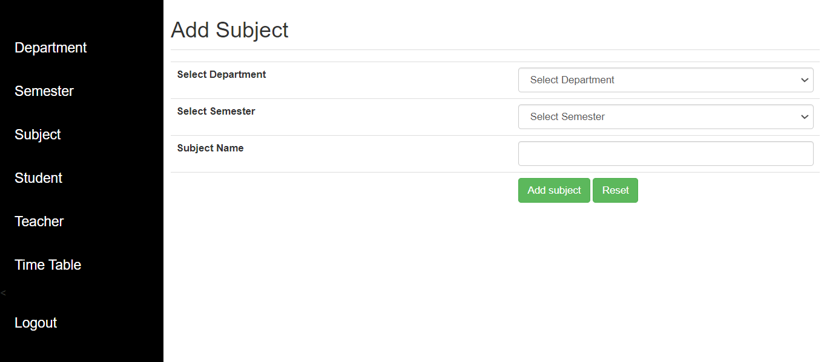
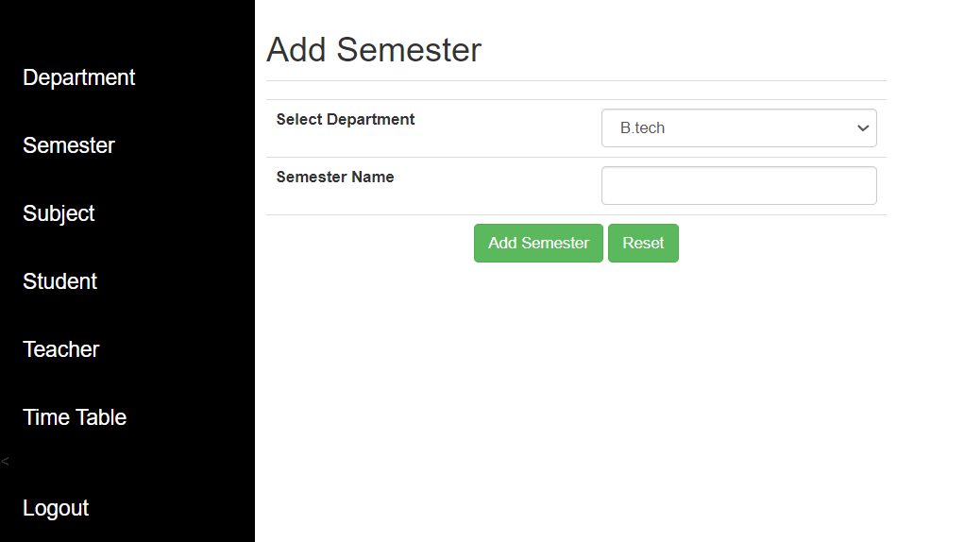
Adding Records

Slide 38
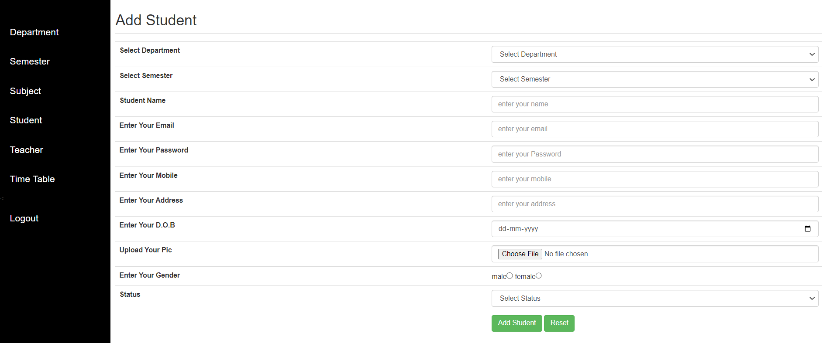
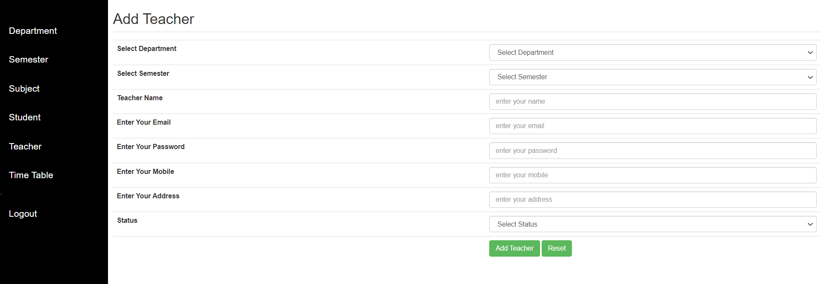
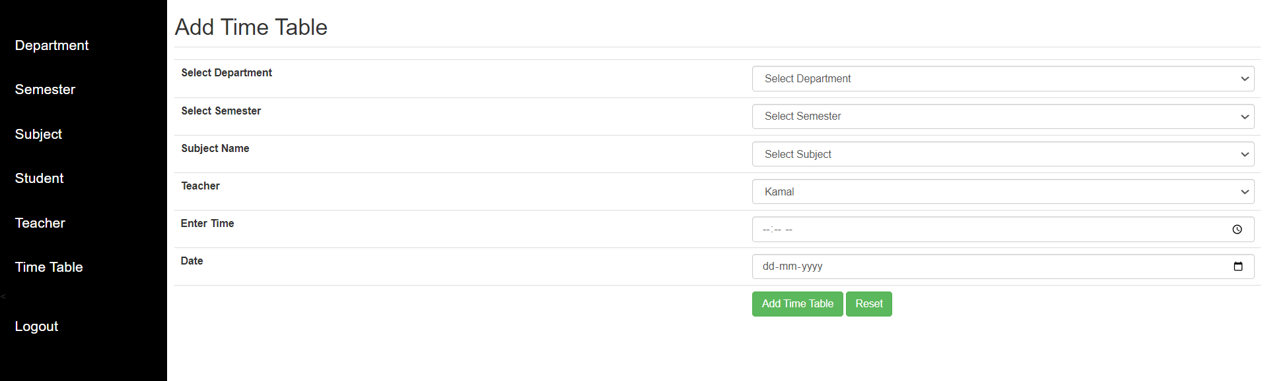

Slide 39

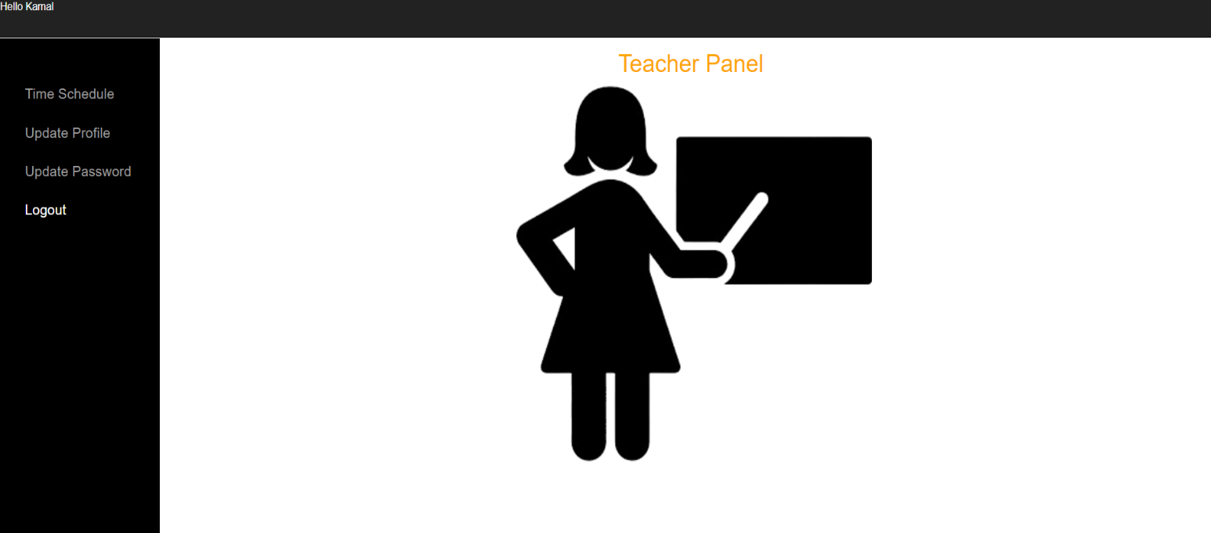
Teacher Panel

Slide 40
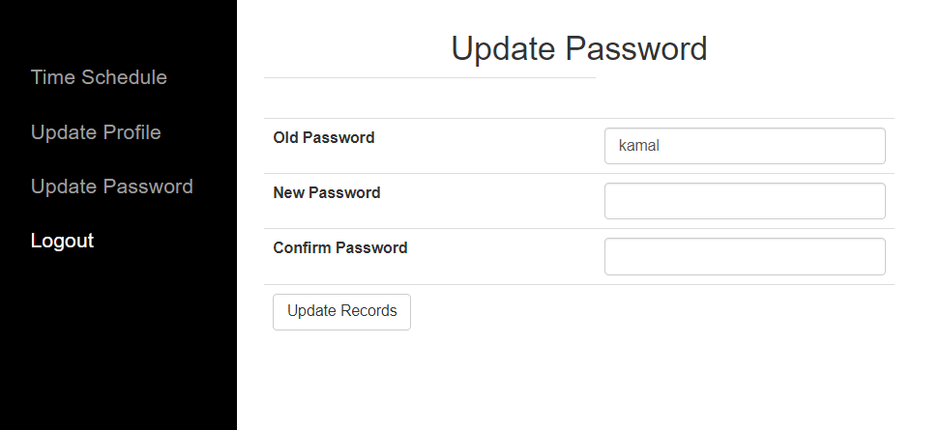
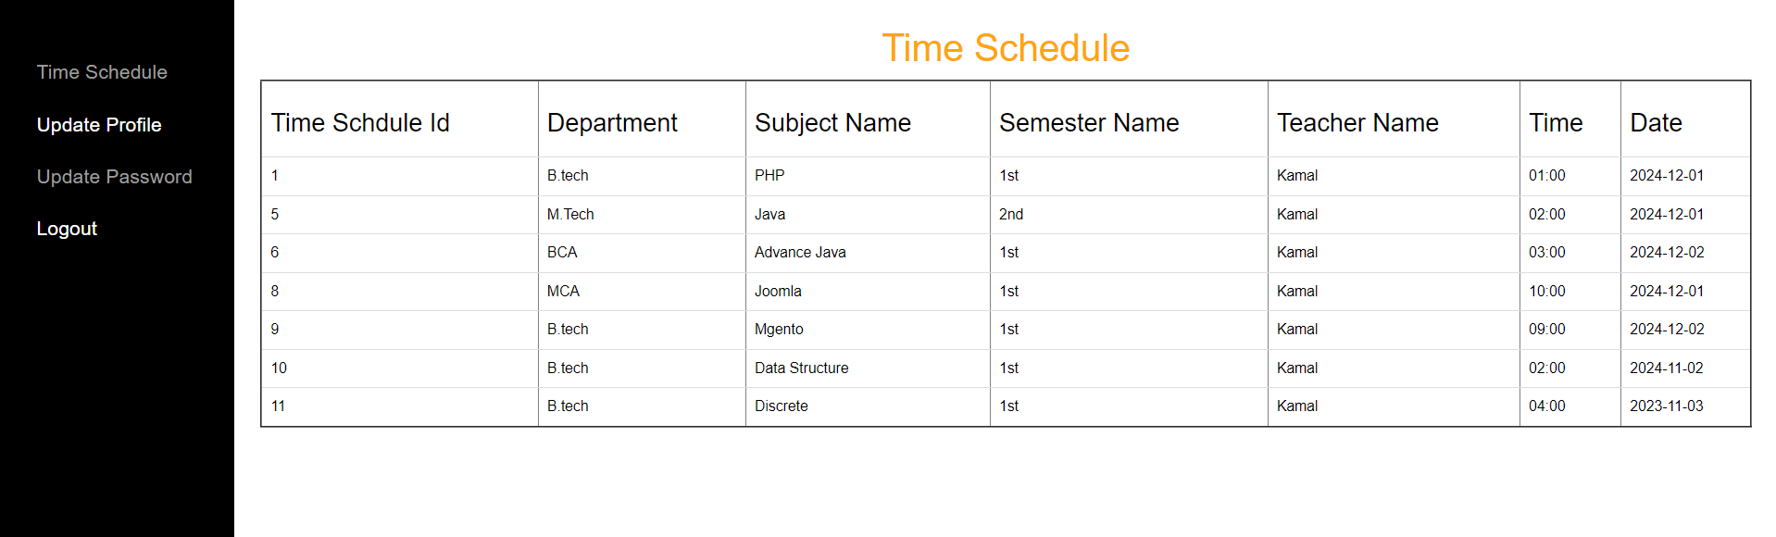
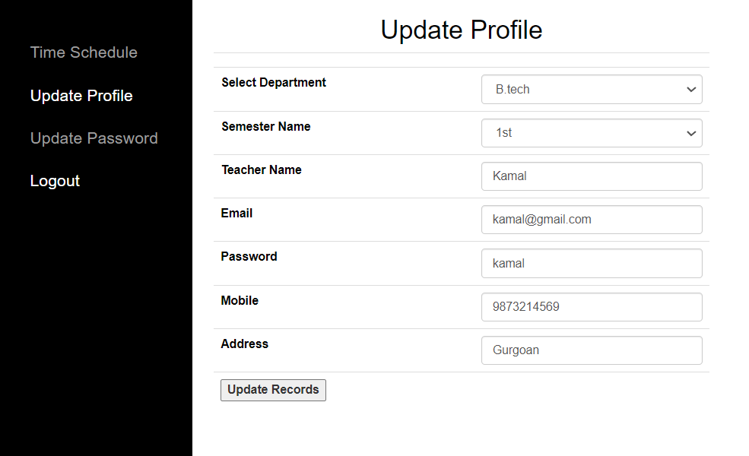

Slide 41

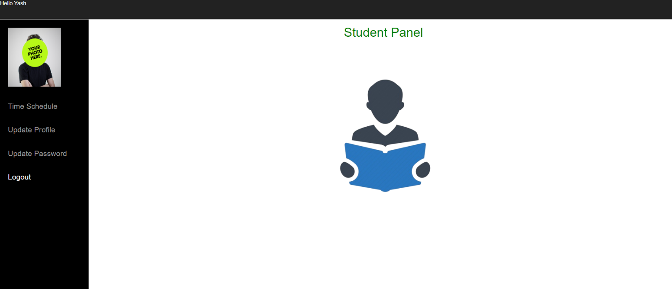
Student Panel

Slide 42
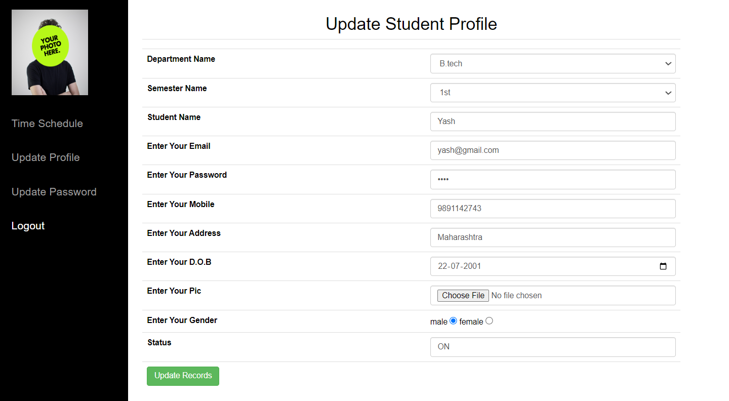
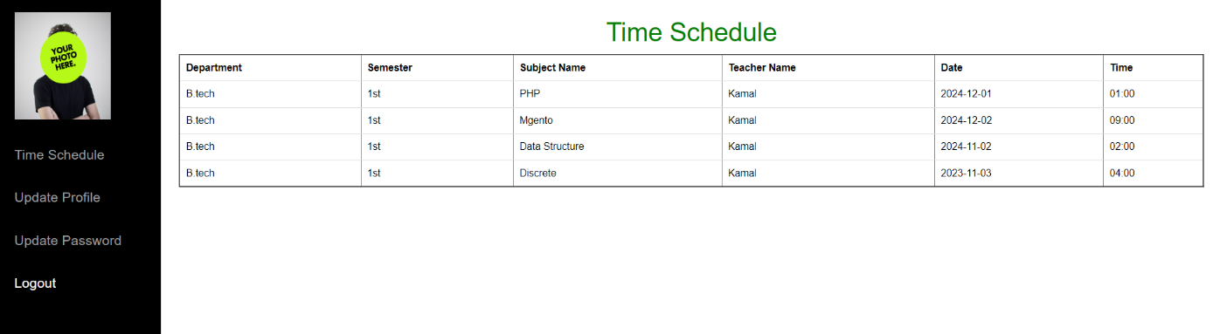
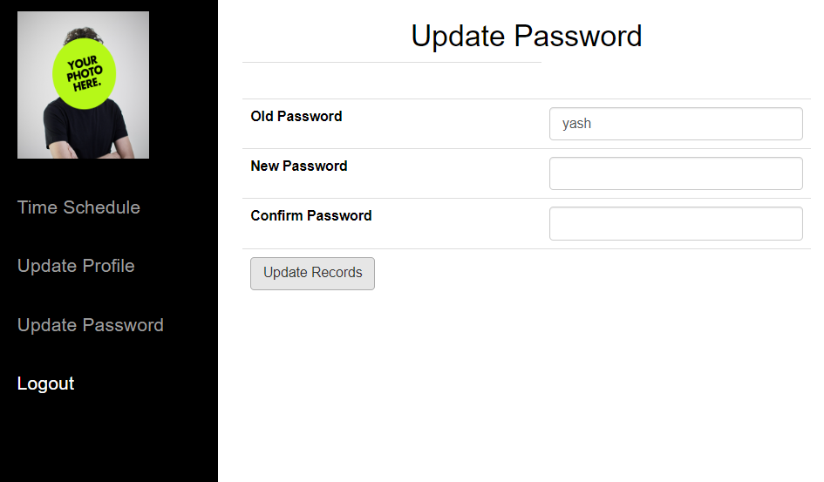

Slide 43
FUTURE SCOPE
Integration of Machine Learning
Mobile Application Development
Expansion to Multi-campus Institutions
Enhanced Analytics and Reporting
CONCLUSION
Time Table Generator is a convenient time table managing website .Time table management may be aided by a range of skills, tools, and techniques used to manage time table when accomplishing specific subjects, semesters, and students. Initially, time table management referred to just work activities, but eventually the term broadened to include personal activities as well. A time table management system is a designed combination of processes, tools, techniques, and methods. Timetable management is usually a necessity in project development as it determines the project completion time and scope
REFERENCES
www.phptpoint
www.javascriptkit.com
www.tutorialspoint.com/php/
W3 school.com

